Slide 1
Belford Primary School’s Eco Review 2021

Slide 2
The school eco review that we carried out showed up our strengths and our weaknesses.
We are really good at Biodiversity, Healthy Living and looking after our school grounds.
We need to work on saving energy, global citizenship, litter, marine life, transport, waste and water.

Slide 3
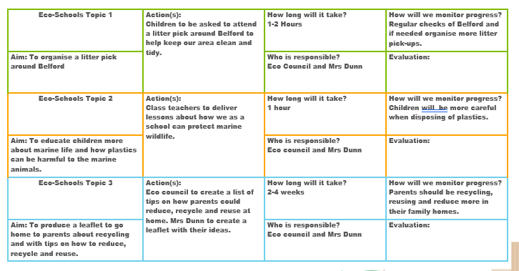
Our Action Plan

